Slide 1

Newly merged College
of Engineering & Science
is an unorthodox approach
to improving our ranking
Nanotechnology is at the
core of it all. To make
anything nano, you need
to surround it with a
barrier of charges.
Biomedical
Engineering
Materials
Science
Chemical
Engineering
Nanotechnology
Physics
Electrical &
Computer
Engineering
Chemistry
Mechanical &
Aerospace
Engineering
Dr. Jim Brenner
Florida Tech
Biology

Slide 2
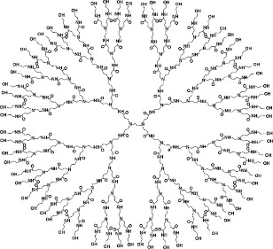
Nanomaterials
Porous Materials
Adsorbents
Sensors
Catalysts & catalyst supports
Porous Si for controlled color
Carbon nanotubes (CNT's)
Metalorganic frameworks (MOF's)
Metal/Polymer/Ceramic Nanoparticles
Noble metals for optical & catalytic apps
Polymers mostly for biological apps
Templates for other nano objects
Metal oxides for anti-infection coatings
Compound semiconductor quantum dots
Dendrites
People use their
curiosity in
nanotechnology to
discover scientific
principles that form the
basis for engineers to
maximize surface area
to volume ratio to
create value for customers
Coatings
Ag, ZnO, TiO₂ anti-infection coatings
Polyethylene glycol (PEG) to minimize protein adhesion
Hydrophobic alkanethiols on Au or Ag
Nanocomposites
Conducting CNT's in ceramic for structural health monitoring
Gold Surface

Slide 3




KEEN’s 3 C’s: Curiosity, Connections, and Creating Value

Slide 4
Nanoscience and Technology Minor Curriculum
Minor Courses Year # of Credits
Nanotechnology Lab I (CHE/CHM 1091) Fresh. 1
Materials Characterization Lab (CHE 4563) Jr. – Grad. Stud. 3
Nanotechnology (CHE 4567/5567) Jr. – Grad. Stud. 3
Materials Science & Engineering (CHE 3260) Soph. 3
Biomaterials (BME 3260 or CHE/BME 5300) Soph. or Sr./Grad. 3
Tissue Engg. (BME 5569/4569) Sr. - Grad. Stud. 3 Independent Study (CHE 4291) or UG Research Jr.-Sr. > 3
Nanotechnology Lab II (CHE 3091) Soph. – Grad. Stud. 3
Quantum Mechanics (PHY 3035) Jr./Sr. 3
Physical Chemistry 2 (CHM 3002) Jr./Sr. 3
The Basics of Making (CHE/BME 4568/5568) Jr./Sr. 3
Biochemistry (BIO 4010) Jr./Sr. 4
Materials Lab (CHE 3265) Soph. 1
Physics 2 Lab (PHY 2092) Soph. 1
BME Measure. & Instr. Lab (BME 4253) Sr. 1
Long list of Nanotech Electives Jr./Sr. 3
1st group: All; 2nd Group: > 3 credits; 3rd Group: 1-2 credits; Total of > 18 credits
One of only six undergrad
nanotech minor programs
in US when instituted
More labs than anyone else
Although nanotech grad
programs are fairly common,
adding a nanochemistry
grad course would be all
that would be needed to start
grad nano program that
would serve as student
feeder to future grad
research growth

Slide 5
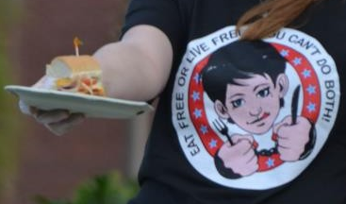
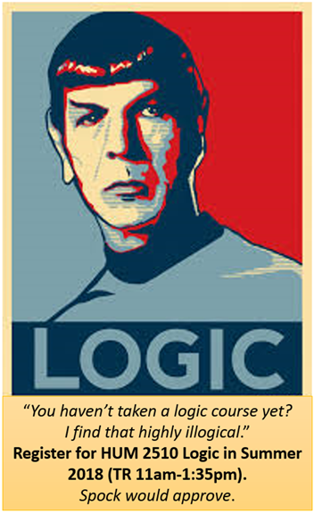
Ted Petersen’s (COM)
Live Free or Eat Free: You
Can’t Do Both Event
Why Restrict the Humanities Elective
I use a lot of cultural references that most people outside FIT
would expect Nanotech Minor students to be familiar with.
2) These cultural references provide the inspiration for future inventions.
3) One minor donor in 2016 and likely others think that a culture of
invention requires the proper philosophy and the freedoms
Americans take for granted.
  What do we know?
  How do we know what we know?
  People will pursue their own rational self-interests if allowed to
  Respect for individual & property rights, including patents
  Appreciation for how invention & innovation built economy
  Re: The Men Who Built America & The Food That Built America
As NanoFlorida was successful in promoting FIT as the home of nanotech
education and the Honors College has gone forward, KEEN rewarded FIT > $500 K with > $100 K to the Nanotech Minor for value we created.
https://www.floridatoday.com/videos/news/local/2015/02/25/24028091
Moti Mizrahi’s
Logic Course

