Slide 1





KEEN’s 3 C’s: Curiosity, Connections, and Creating Value

Slide 2
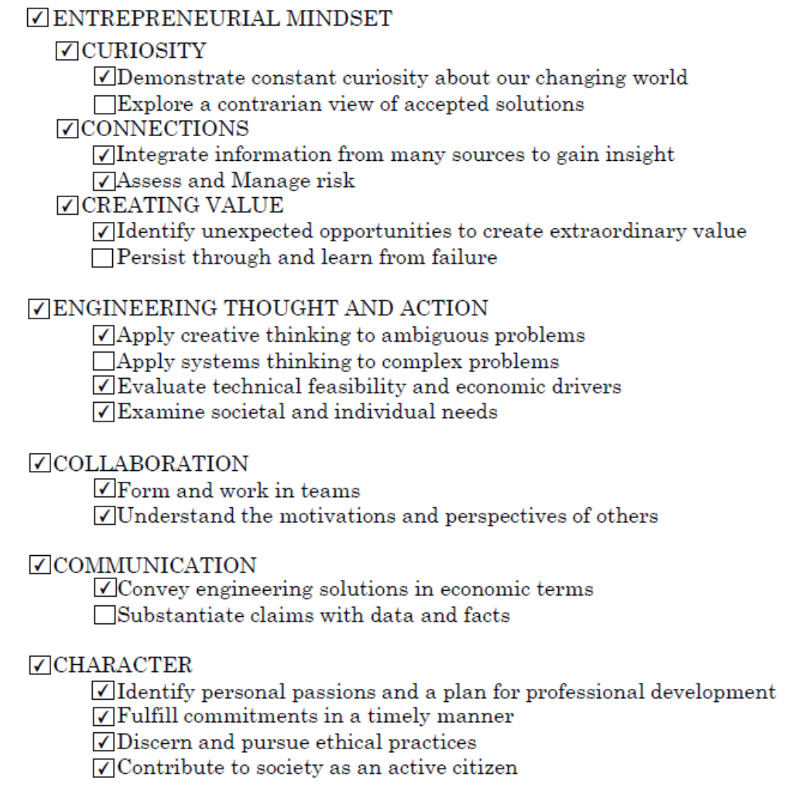
KEEN Complementary Skills
KEEN = Kern Entrepreneurial Engineering Network
http://engineeringunleashed.com/Mindset-Matters.aspx

