Slide 1
KEEN Faculty Engagement Introduction
The Florida Tech KEEN Team Tuesday, Sept. 28th, 2021
Drs. Marco Carvalho (PI), Sen (Co-PI), Brenner, Slhoub, Weaver, Hamed, and Mesa-Arango

Slide 2
Who are you? What course(s) are you teaching? What teaching resources do you wish were available? How can we (KEEN team) help?

Slide 3
What is KEEN? How is Florida Tech involved in KEEN? How do educators like me benefit from KEEN? Are my colleagues doing it? How can I join?

Slide 4
The Kern Entrepreneurial Engineering Network
A part of the Kern Family Foundation (kffdn.org)
A network of over 3000 engineering faculty from over 50 U.S. schools
Mission: “To graduate engineers with an entrepreneurial mindset (EM) so they can create personal, economic, and societal value through a lifetime of meaningful work.”
Transform engineering education through the collaboration of faculty members

Slide 5
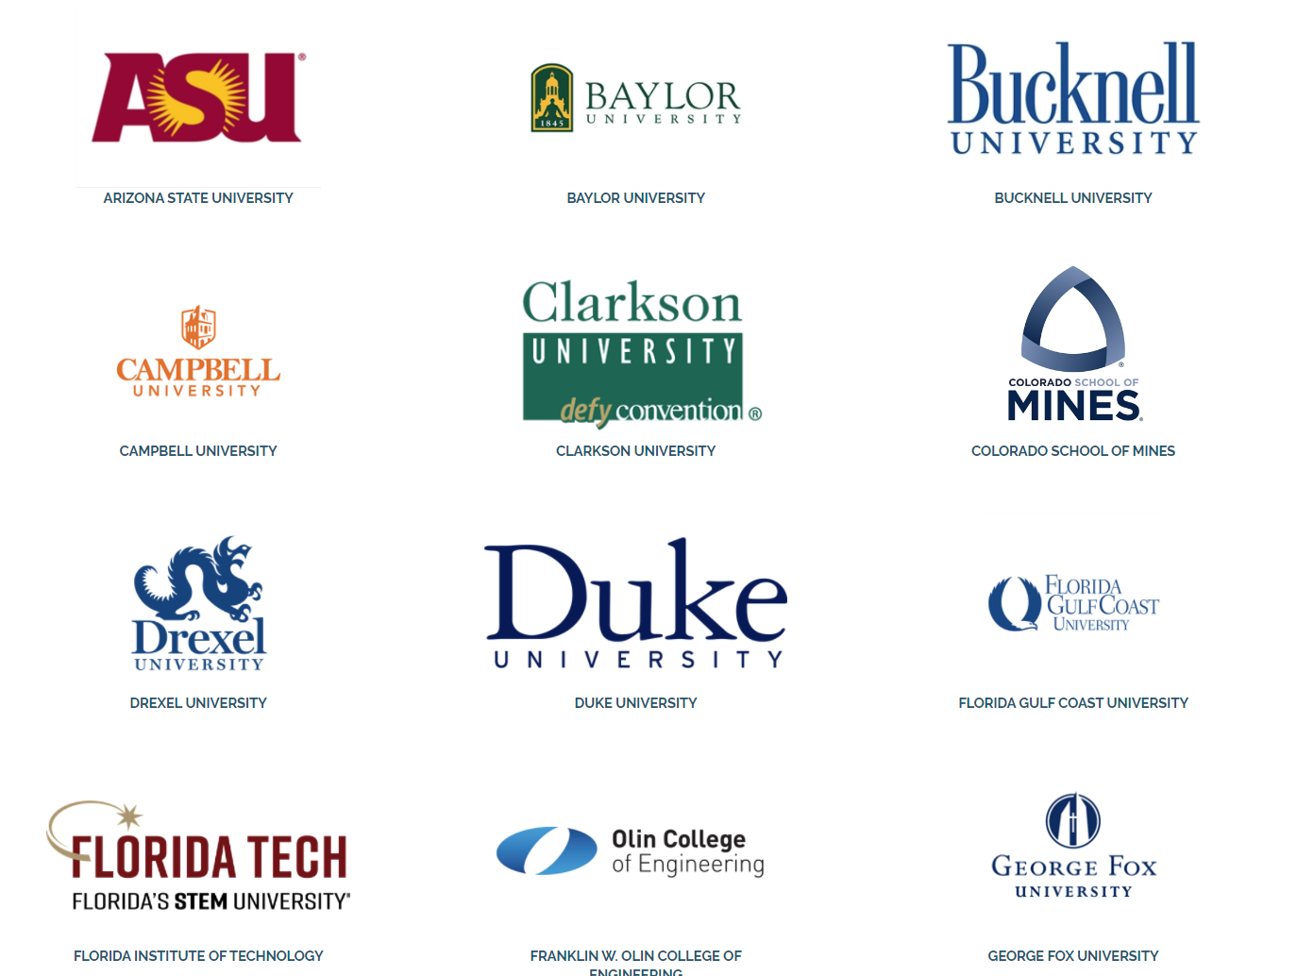
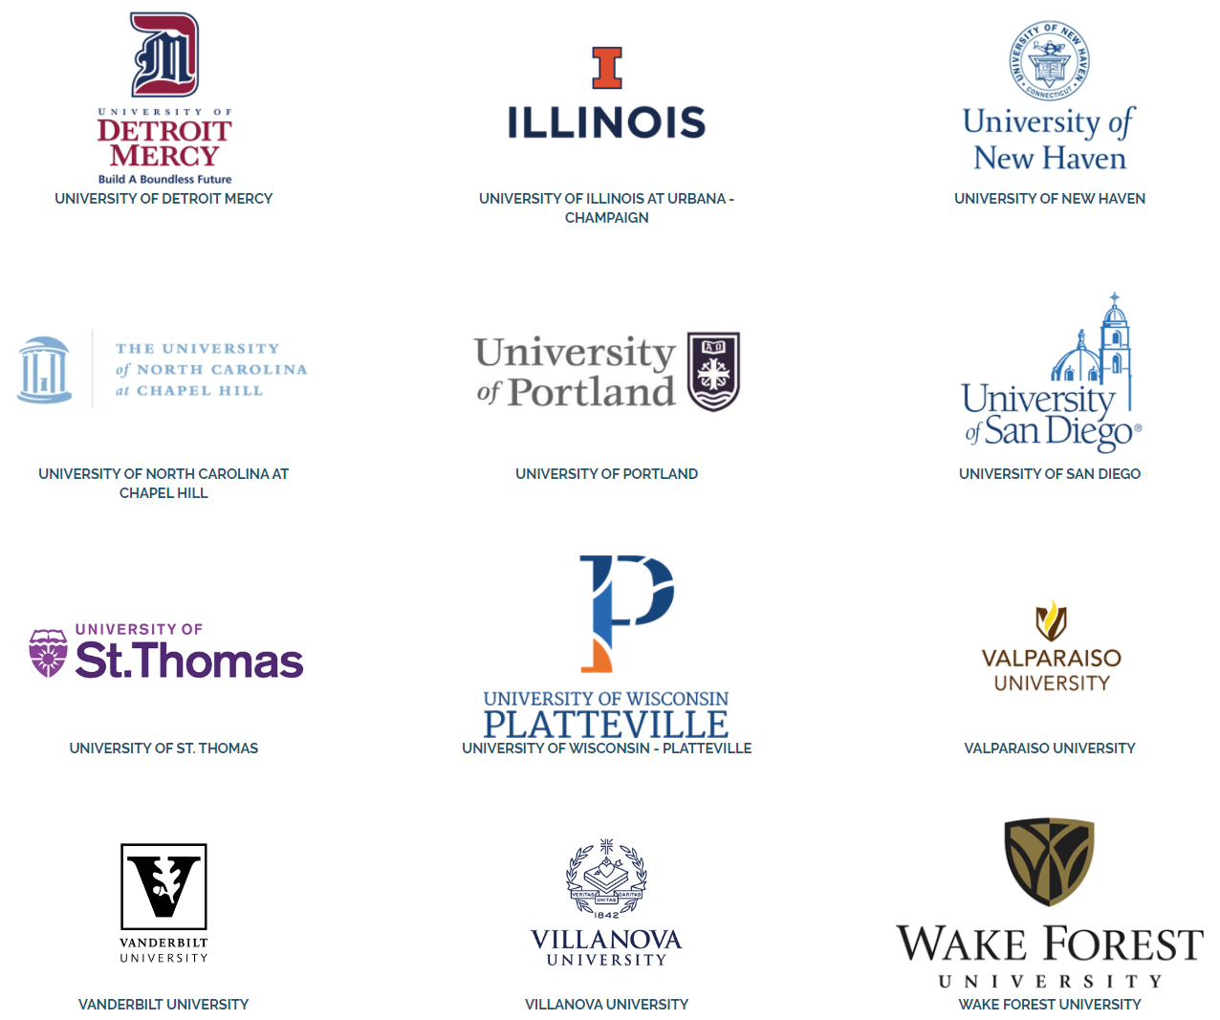
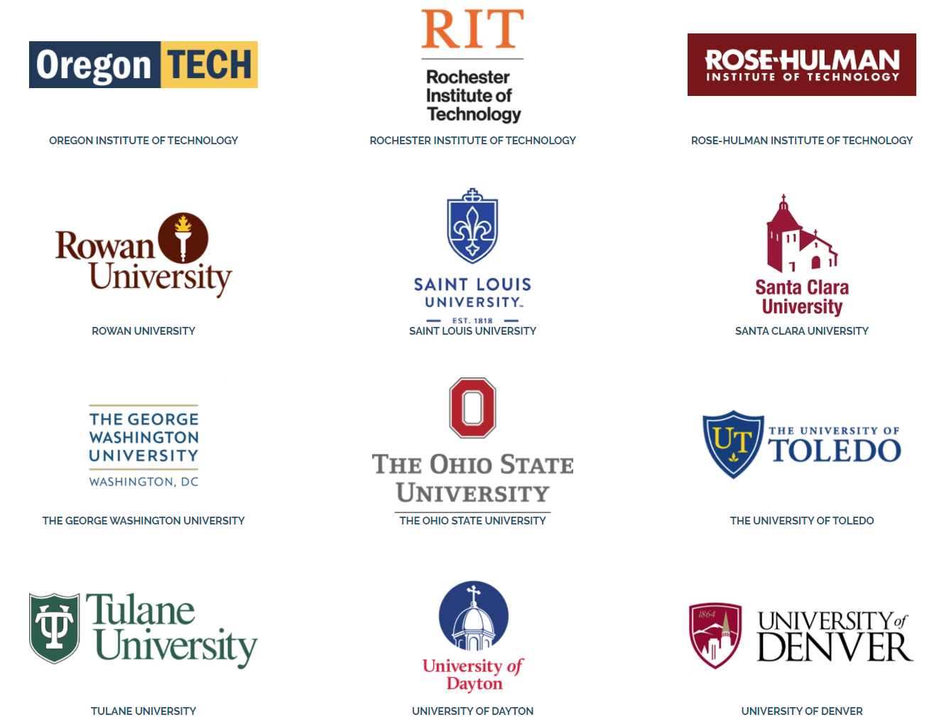
KEEN Partner Schools “network of faculty rather than schools”

Slide 6
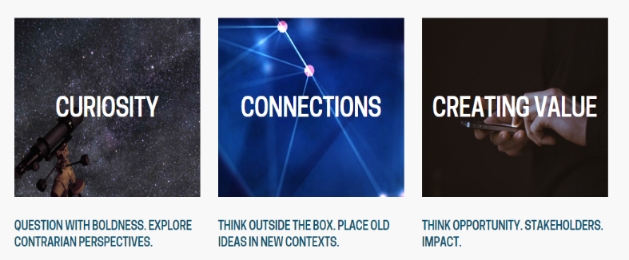
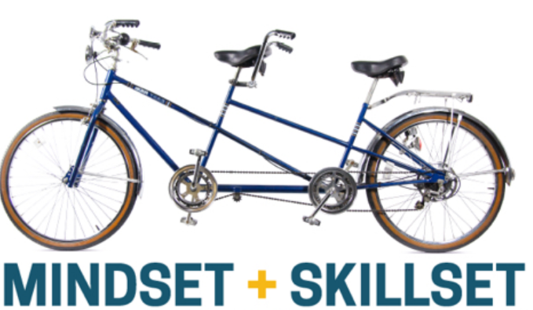
What is the Entrepreneurial Mindset (EM)?
CURIOSITY: Helps individuals investigate and understand a rapidly changing world.
CONNECTIONS: Making connections between unrelated areas often provides innovative solutions.
CREATING VALUE: “Innovative solutions are most meaningful when they create extraordinary value for others.”

Slide 7
How is Florida Tech involved in KEEN?
Currently on the second institutional grant from KEEN
PI: Dr. Marco Carvalho, EVP-A and Provost
Core Team: Drs. Brenner, Slhoub, Weaver, Hamed, Mesa-Arango, and Sen (Co-PI)
Purpose: Improve undergraduate education by fostering EM Develop methodology for EM in STEM through making experiences
Focus: Faculty engagement across STEM campus

Slide 8
How do educators like me benefit from KEEN?
Fostering EM can make you a better educator
A growing body of shared instructional resources (CARDS)
1600+ educational modules, created by faculty of the network
Slides, syllabi, notes, assignments, rubrics, sample work, and instructions for adopting
Stored in card form at engineeringunleashed.com (need only a free account)
Gateway: https://www.engineeringunleashed.com/card/2167
An opportunity to contribute your content to the network
Financial incentives available for different levels of engagement
Paid travel to KEEN conferences, trainings, and workshops – excellent feedback
The KEEN core team will help you every step of the way

Slide 9
Are my colleagues doing it?
~50 of 90 fulltime CoES faculty are engaged at different levels
15 COES faculty trained in EM through on-campus workshops (Fall 2019)
15 modules and cards by Florida Tech faculty members
Recent examples of EM modules from the Fa19 on-campus workshops here at Florida Tech:
Najafi: Energy Sustainability: A Semester-Long Assignment https://www.engineeringunleashed.com/card/2348
Suksawang: Timber Building Design Challenge https://www.engineeringunleashed.com/card/214
Kishore: Self-Learning Biomaterial Selection Module https://www.engineeringunleashed.com/card/210
Mesa: 3Cs in Research-Based Project Evaluation https://engineeringunleashed.com/card/200
2020 KEEN conference: 15 CoES faculty from Florida Tech attended
~1,155 of 1,513 CoES students have been exposed to EM modules

Slide 10
How to find a card in your discipline
The One CardDeck to Rule Them All https://engineeringunleashed.com/card/2167
2020 KEEN fellowship winner:
Coastal Structures: Designing for Uncertainty, Designing for Failure https://engineeringunleashed.com/card/2266
How to adapt a card to fit your discipline:
Roadway Design: Designing for Uncertainty, Designing for Failure https://engineeringunleashed.com/card/2450
Cards outline activities, modules, courses, etc. they apply EML and can be used to teach concepts or entire courses.

Slide 11
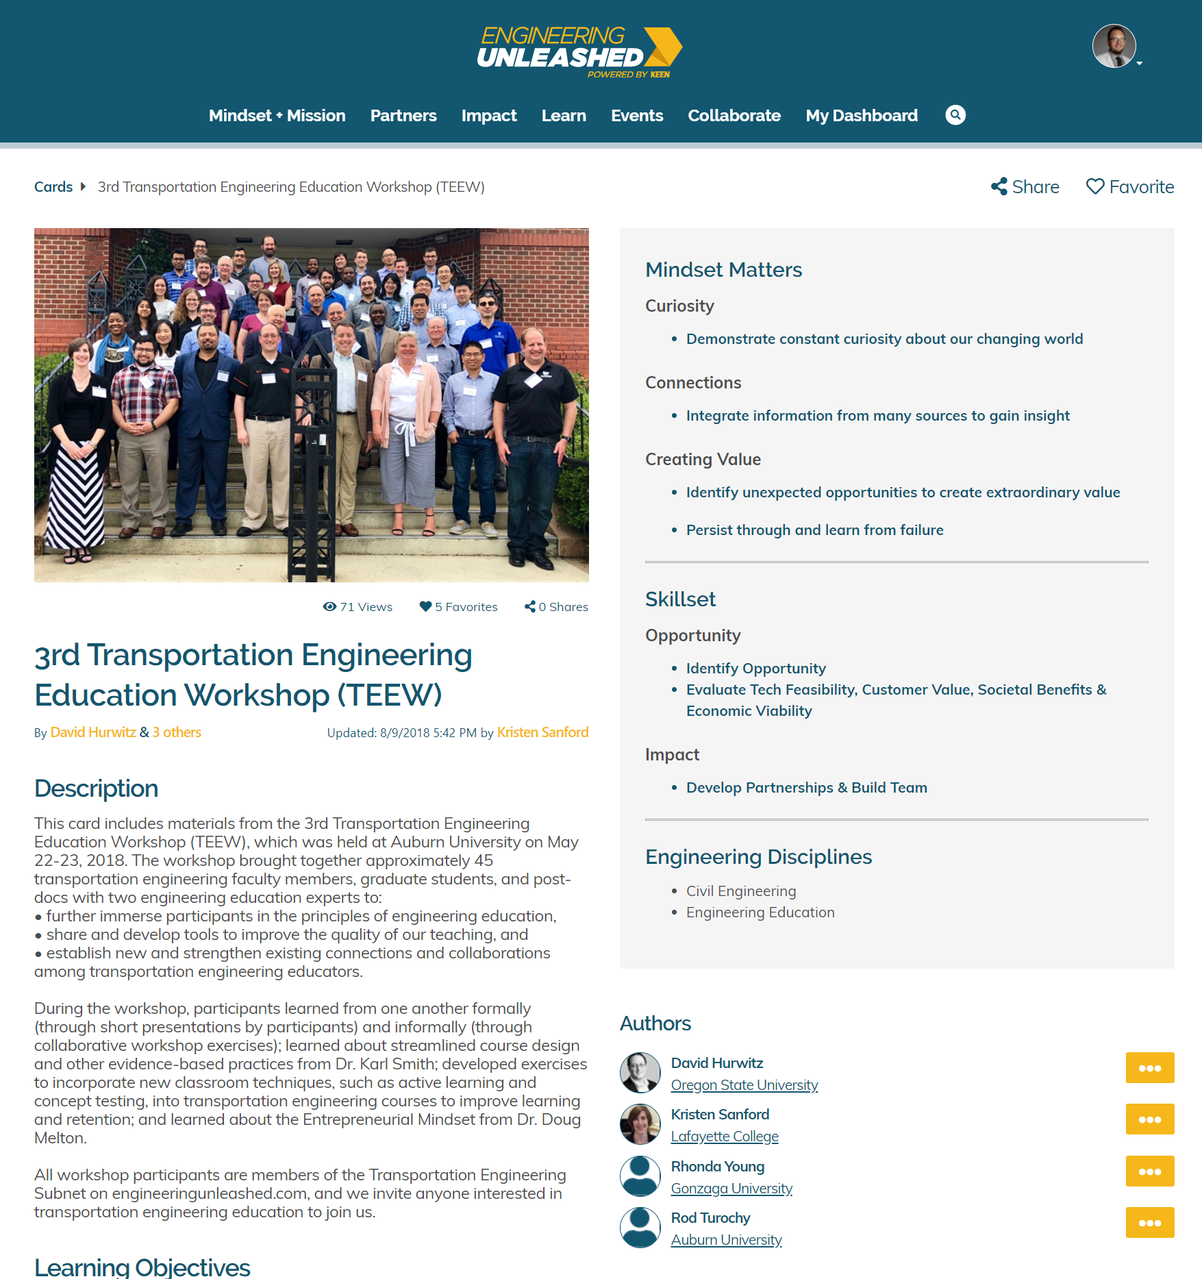
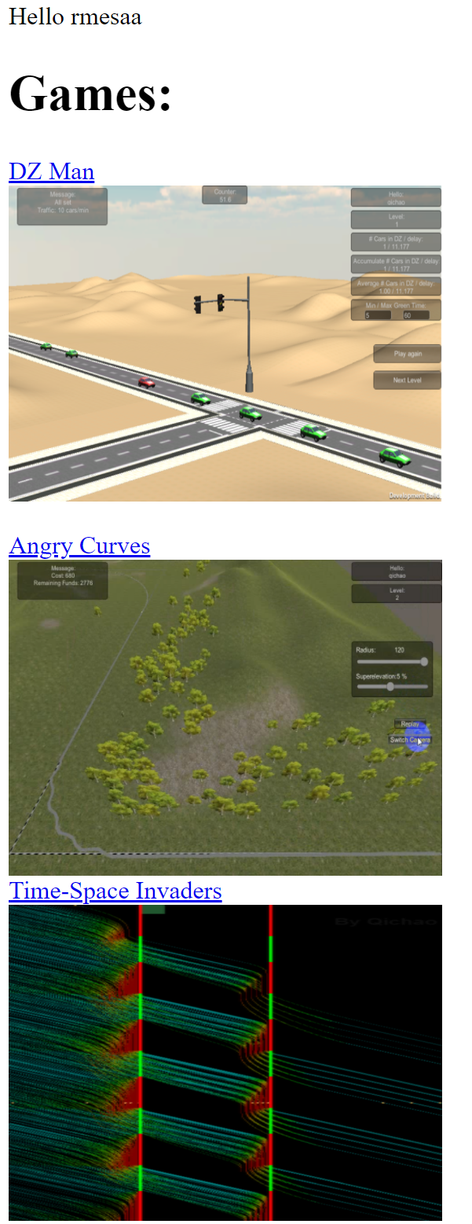
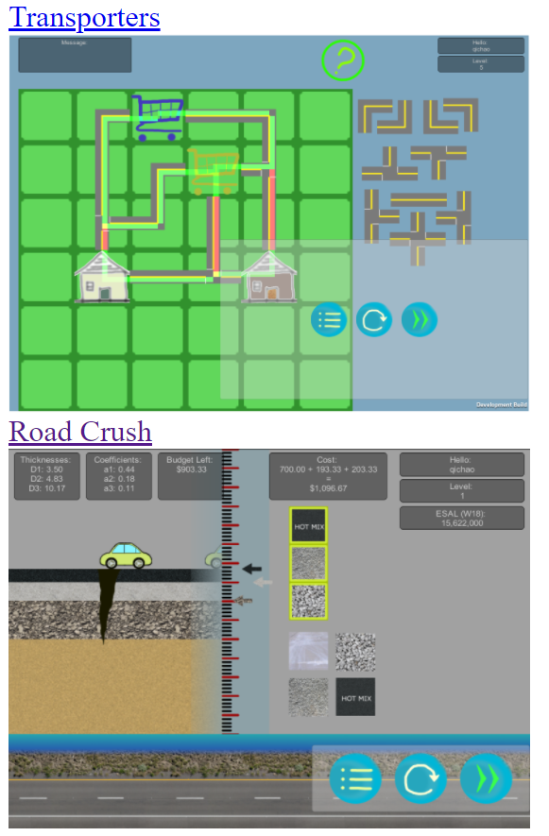
How Have Florida Tech Faculty Benefited from the Cards? (Mesa-Arango)

Slide 12
How Can I Join?
Basic
Contact your department’s KEEN members
Create a free account on https://www.engineeringunleashed.com
Familiarize yourself on KEEN and EML (start watching videos)
User
Use the cards: download, adapt, and use them in your classes
Contributor
Attend the 2020 workshops for EM modules (TBA: Nov. 2020)
Develop an EM module for your own course (KEEN core team will help)
Implement the module in your class (KEEN core team will help)
Publish a card (KEEN core team will help)
Receive a monetary incentive reward!

Slide 13
Thank You!
Questions

Slide 14
Elements of A Unified Keen Vision for EM & Research Training
An EML-focused first year experience (FYE) as an alternate or replacement for traditional FYE courses (not to be funded as part of this grant)
A making experience in the first year and at least one other time before senior year, with my Basics of Making course (https://fit.instructure.com/courses/551142) offered to juniors, seniors, and grad students
A literature review component that addresses pain points for both faculty and students and that is vertically integrated through the curriculum
Discipline-specific skill development
Integrating our research and our teaching as much as possible

Slide 15
