Slide 1
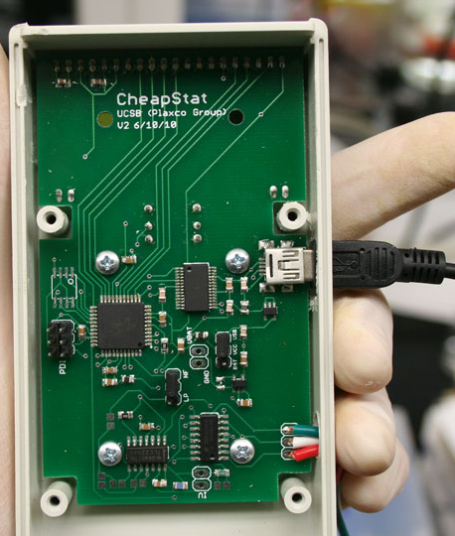
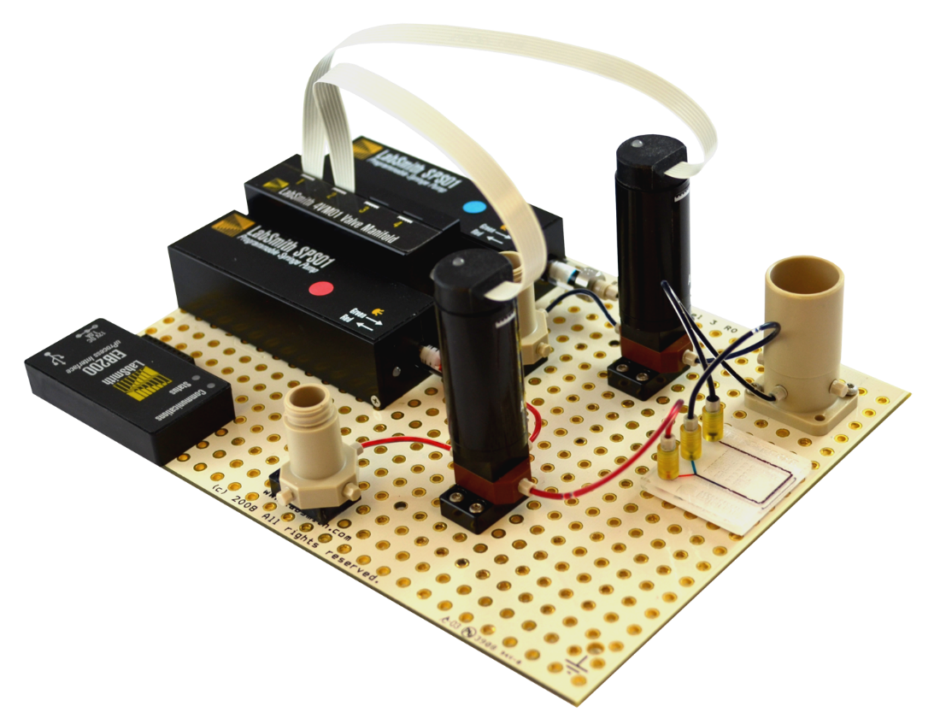
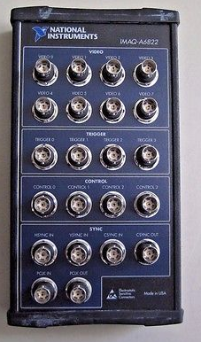
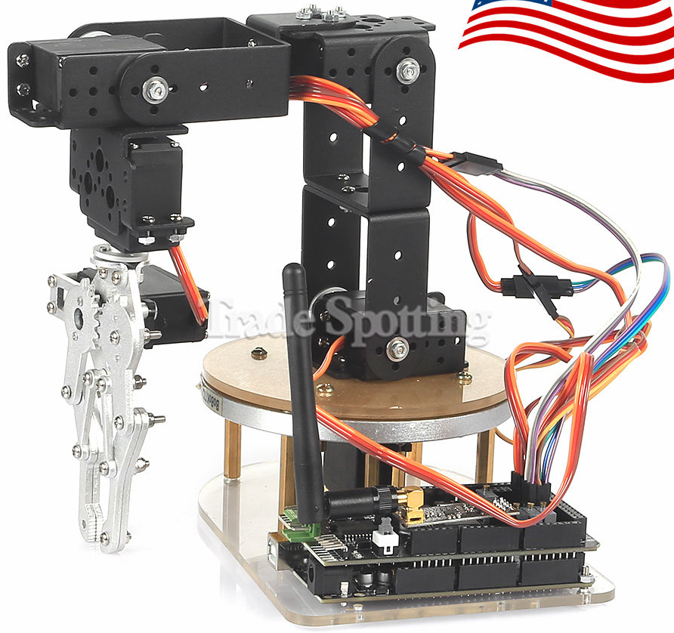
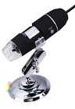
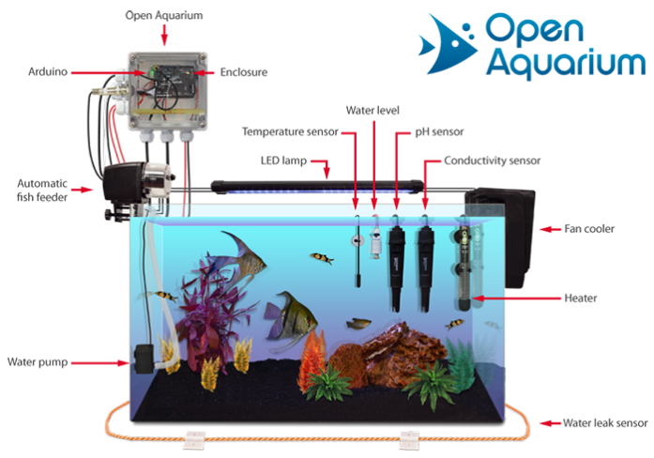
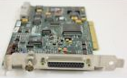
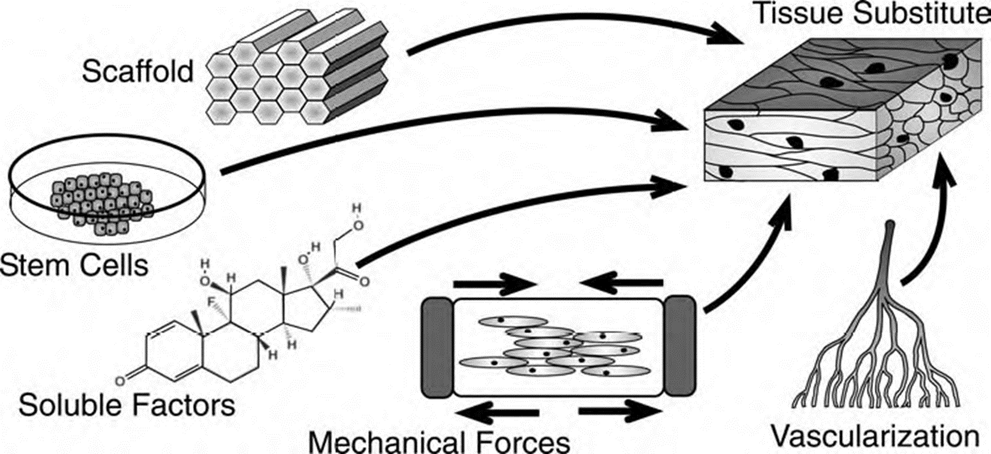
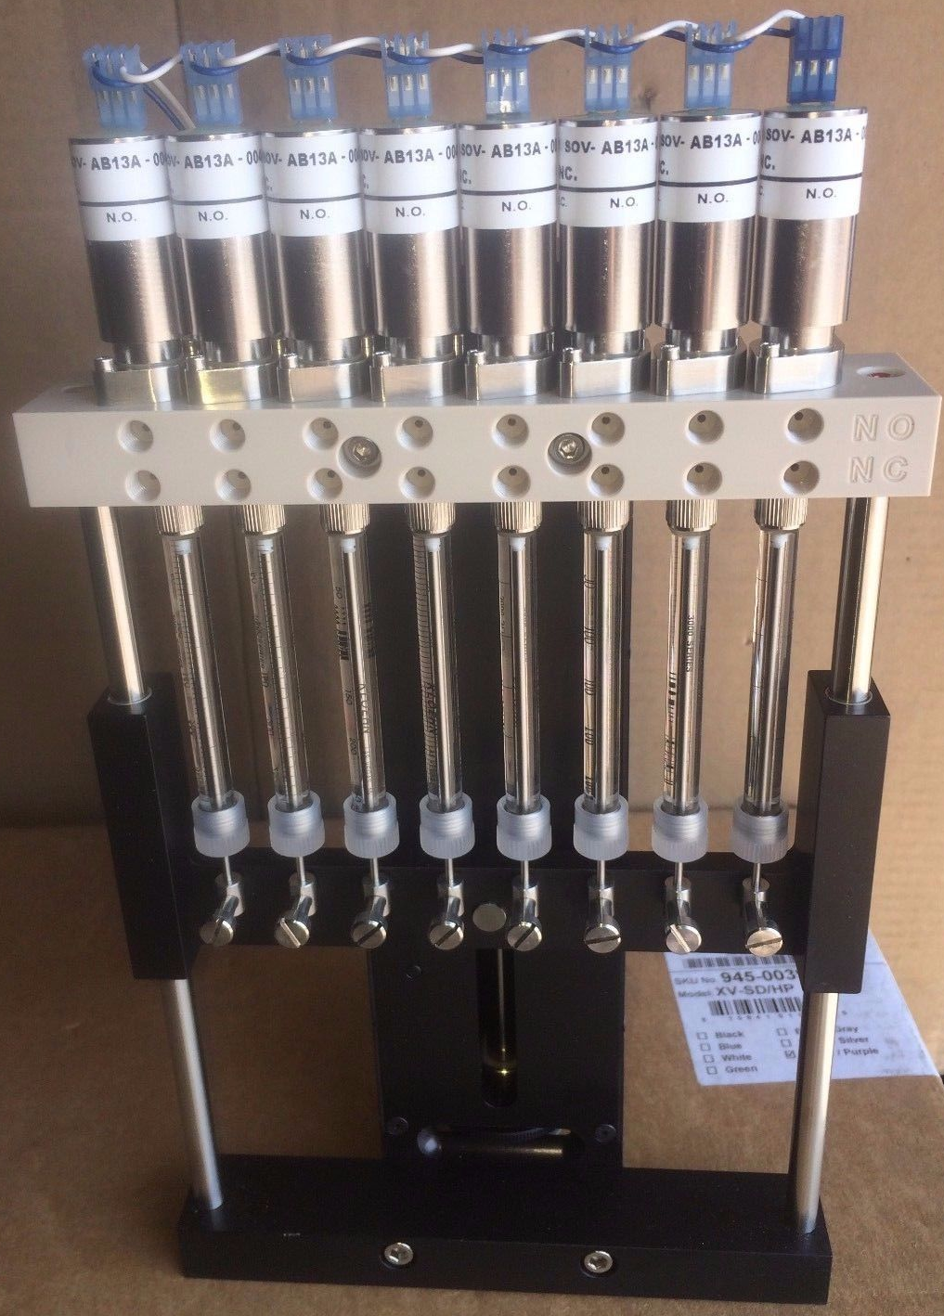
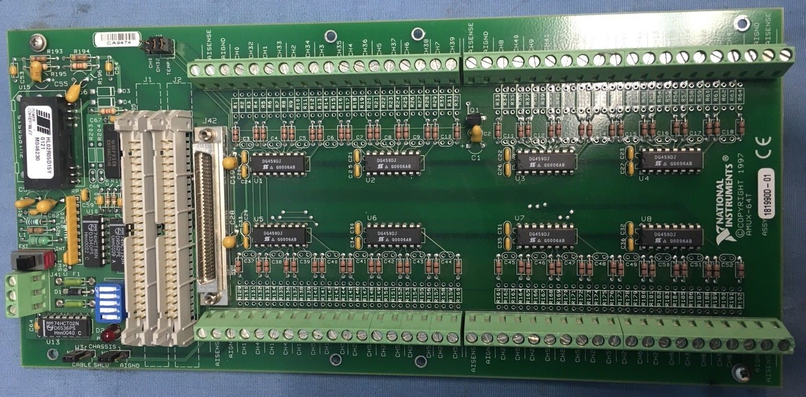
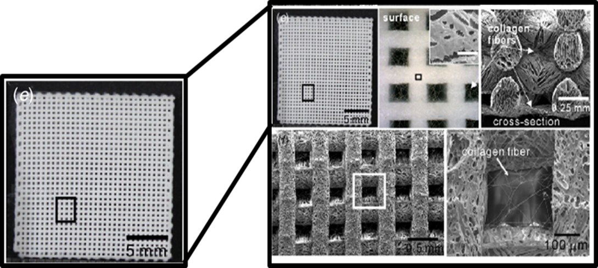
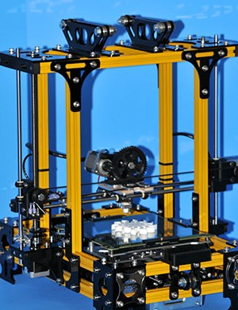
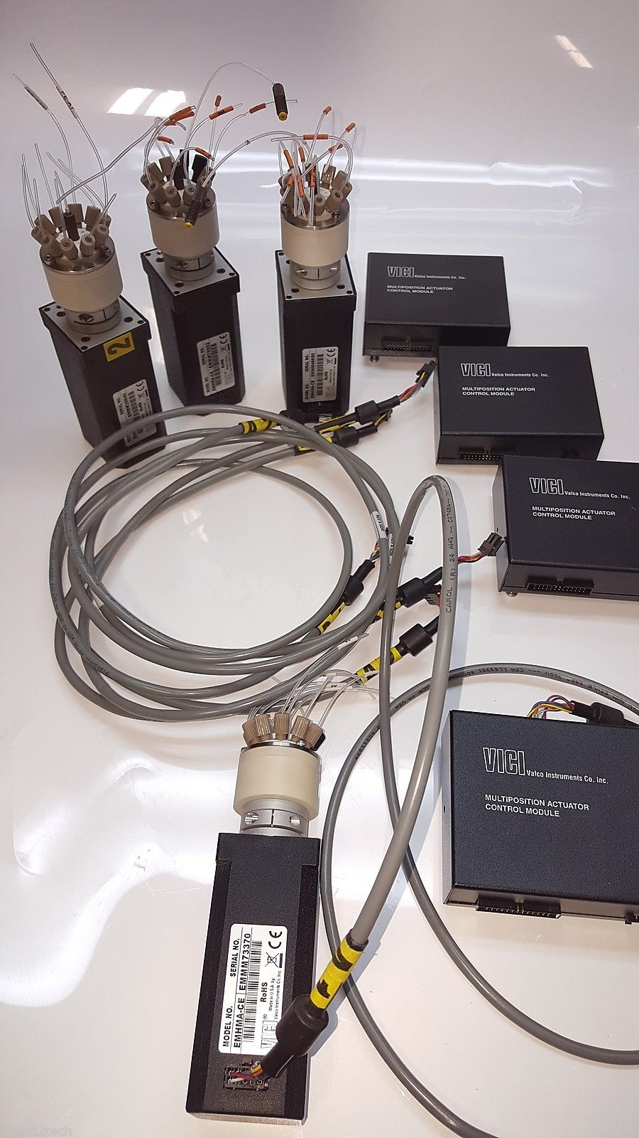
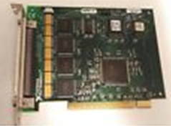
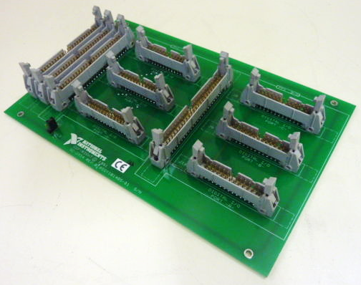
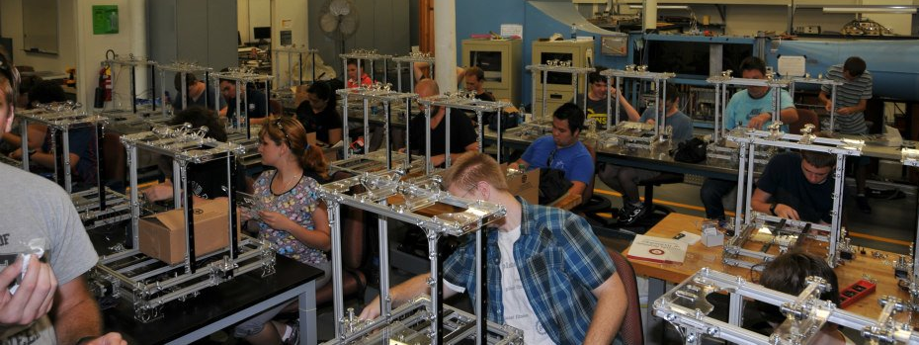
Tissue Engineering Problems
Researchers don't have funding or equipment to automate tissue
engineering development process
A lot of time wasted on emptying cell waste + feeding eells
Lack of samples in a set amount of time → Reproducibility issues
Most researchers stop at cell growth, and neglect the fact that the cells
must integrate together to form a tissue
Difficult to maintain balance between porosity, micropore size, mechanical
strength, and absorption kinetics of a scaffold
Growth factor delivery methods - bolus injection ineffective
TURNING TISSUE ENGINEERING INTO AN ENGINEERING DISCIPLINE
Adrien Hosking, Jonah Melegrito, Princess Akande, Nicole Bueno, Guochang (Nick) Ye, Timofey Broslav, Ziyad Al Hinai, Thomas Quaid, Thomas Ward, Kristen Brenner, Soha Patil, Dallas Nash, Megan Bass, Kyle Kercher, Jair Cowie-Williams, Ferron van Ritter, Dylan Huss, Fahad Meghrbel, Ralston D’Cunha, David Beavers, and Prof. Jim Brenner*
Florida Tech Chemical, Biomedical, Mechanical, and Aerospace Engineering Departments & Nanotechnology Minor Program
150 West University Blvd, 256 Olin Engineering Bldg., Melbourne, FL 32940,
http://my.fit.edu/~jbrenner; *PHONE: (321) 749-3437; *E-mail: jbrenner@fit.edu
ACKNOWLEDGEMENTS: LabSmith for “Free” Kit as part of NSF SBIR 1621630 beta testing
“PATIENT” MONITORING
Voltammetry Cell with Cheap, Disposable Chip and USB Cable from Pine Research
We will use low volume multielectrode version I
used 10 years ago for an electronic nose project
Carbon Counter
Electrode
Ag/AgCl Reference Electrode
Literature analysis showed that Vanderbilt & Harvard/MIT have most sophisticated, automated setups with 8-10 parallel bioreactors. How to outmassproduce?
All of this for ~$20 K per bioreactor → How to simplify & cut costs?
IF BUDGET WERE UNLIMITED, WHAT WOULD YOU DO?
Have many bioreactors running in parallel with automated nutrient supply, waste removal, with at least periodic electronic “patient monitoring” similar to that in a hospital
Automation minimizes reproducibility issues
Arrays of bioreactors allow for systematic evaluation of synthesis, &/or culturing variables, continuous or pulsating flow rates or voltage stimulations, etc. for tissue engineering
Arrays of syringe pumps allow for much greater control over mechanical properties of candidate scaffolds
Working
Electrode
CHEMICAL/ELECTROCHEMICAL/BIOLOGICAL
REACTOR INSTRUMENTATION
Multiport Valves for Synthesis and Feed Inputs
Inputs
Synthesis
Phosphate Buffered Saline (PBS)
Glucose
Microscope
Bioglass Precursors
Cells
Growth Factors
Dye A
I
Polymer Precursors
2
Differentiation Factors
7
Dye B
Heating Jacket Aquarium
10-way Valve
3
1
6
8
Reactor
H
1
3
DD Water
9
A
B
C
D
E
F
G
J
K
Crosslinkers
Drug
5
10-way Valve
Bioreactor Add-on
O_{2(g)}
4
10
Load Cell
12
13
11
Glucose, Lactate, & O₂ Concentrations
with Sensors from BioLogic & ALS-Japan
https://www.als-japan.com/1379.html#defaultTab13
https://iorodeo.com/products/cheapstat-open-source-potentiostat
http://stuff.iorodeo.com/docs/potentiostat/ and links including potentiostat_shield_schematic_v0p1r2.pdf
http://web.chem.ucsb.edu/~kwp/cheapstat/ https://www.pjrc.com/teensy/teensy31.html
Legend:
A: Liquid Level Sensor E: Oxidation/Reduction Potential H: Aquarium Liquid Temperature Sensor
B: Reactor Temperature Sensor F: Glucose Concentration Sensor I: Aquarium Ambient Temperature Sensor
C: pH Sensor G: Lactate Concentration Sensor J: Fiber Optic LED Microscope Camera
D: Conductivity Sensor Not shown: Flow Totalizer K: Dissolved Oxygen Sensor
Bubble Trap
To Array of 36 Bioreactors
14
LabSmith Collaboration
“Free” ($3K) Kit in Exchange for
Beta-Testing Results for Their
NSF SBIR + Reactor Prototype
Open Aquarium Arduino Sensors
A1
FROM ARRAY OF BIOREACTORS
A2
A3
Syringe Pumps
Valve Control
A4
Secondary Concentration
Analysis and Purification
3-Way Valves
5 mL Waste/Product Tank
A5
A6
10-way Valve
A7
51
49
Concentration Analyzer
(GC/HPLC)
Purifier (Kidney)
Waste
50
Laminar Flow
Visualization
Lab-on-a-Chip
49
SainSmart DIY 6-Axis DOF Servo Control
Palletizing Robot Arm for Arduino (above)
National Instruments PCI-IMAQ-1408 Video Frame Capture Image Acquisition Board (left) with IMAQ A6822 accessory (above left) for microscope (above right) inputs for each bioreactor
1 mL Feed Tank
1/16” PEEK Tubing
Being Added on 2nd Board:
Chem/Bio/Electrochemical
Reactor with In Situ
Concentration Analysis
TO ARRAY OF BIOREACTORS (through recycle streams)
R1
10-way Valve
Communicates with
Computer to Control Everything
R2
R3
R4
R6
http://labsmith.com/wp-content/uploads/2017/03/Completed-Assembly-of-Demonstration.png
LabSmith Education Kit Reynolds Number worksheet.pdf
Kit includes pH, H₂O level, conductivity (for salinity), temperature, and Arduinos
& most importantly detailed instructions & Arduino code … all for 368 euros!
R5
https://www.cooking-hacks.com/documentation/tutorials/
open-aquarium-aquaponics-fish-tank-monitoring-arduino/
R7
Scaffolding for Tissue Engineering
Syringe Pumps
Used with analog control to control ratios of flowrates of collagen, Bioglass, crosslinker, cells, growth factors, & differentiation factors
Used with digital control to dose dyes, PBS, DD purge H₂O, drugs, etc.
Example of How to Connect Arduino to Flow Totalizer
NI AMUX-64T Multiplexer
Top: UKSB2006/ePoster/images/
background/ElectrospinFigure.jpgrence)
Bottom: 3D printed coarse mesh
with electrospun fibers superimposed
(Lien, et al., 2009)
All 3D printing projects in Brenner’s research group evolved out of goal to make 3D printing for tissue scaffolding inexpensive.
For allowing a data acquisition card with 16 analog inputs to be used to acquire up
to 64 signals, and if daisy chained to three other multiplexers, up to 256 signals as
is necessary when acquiring data for 36 bioreactors in parallel with one computer
So along came GBotz!
Arduino code for all sensors is freely downloadable with sensor purchase
https://www.atlas-scientific.com/_files/code/arduino_flow_sample_code.pdf
Invented by Martin Gallagher
in Orlando, FL
First printer with lead
screws on all axes being retrofitted
with syringe pumps (below right)
to be Arduino-controlled
Mr. Gallagher and Mr. David Beavers of FIT CoE partnered for FIT 3D Printing Summer Camps
(below left photo)
http://research.fit.edu/
electronic-support-lab/
VALVE CONTROL SYSTEM
Task Plan
Valves & Valve Controllers 12/31/17
Flowsheet and P&ID 2/1/18
Poster 2/21/18
Arduino-Based Sensors – Each Type Working 2/28/18
LabSmith Demo 2/28/18
CAD Drawing of Bioreactor + Feedthroughs 3/13/18
Syringe Pumps Working 3/31/18
Tested Bioreactor Prototype 4/30/18
Purchase Sensors for 36 Bioreactors 5/15/18
Connect Sensors for 36 Bioreactors 6/15/18
Mass Produce 36 Bioreactors 7/4/18
In Vivo Microscopy 8/1/18
LabView Code 8/10/18
Robotic Arm Biopsies to Microscope Slides 9/15/18
Nanoflorida Demo 10/5/18
Stackable, 3D Printed Bioreactors
Valco/VICI multiport valves & controllers
(18 @ $25 ea. on EBay; ~$1000 ea. new) for
sending fluid from syringe pumps to/from
bioreactors for feed, purge, and waste removal
Spin Ω
Five NI DIO-96 cards
($25 ea. on Ebay; $100 ea. new) to send control signals to six NI SC-2054 boards ($40 ea. on Ebay; $100 ea. new), which then in turn, send signals to 18 valve controllers to allow all fluids to be sent to/from up to 36
bioreactors,
allowing us to
outmassproduce
competition
3D printed shaft for mixing
Purchased gears and motors
Stackable bioreactors to fit in incubator
Qian et al., 2016,
Cell, 165, 1238–1254
May 19, 2016, Elsevier Inc.
http://dx.doi.org/10.1016/j.cell.2016.04.032
mmc5.pdf, mmc1.pdf, and mmc4.pdf
+ .stl files
Our 3D printed bioreactors will have use
their mixer, but otherwise just be similar
50 students @ 2 camps, including
20 FIT students
Contact David Beavers at
http://my.fit.edu/~bdavid

