Slide 1
Laser Cutting
Fall 2022

Slide 2
Overview
Introduction
Laser Beam
System of Mirrors
Machine and Equipment
CAMFive
Chiller
Laser Tube
Fume Extractor
Laser Bed
Laser Cutter Software
Cutting vs. Etching
Laser Cutter Material
Laser Cutter Applications

Slide 3
Introduction
What is a Laser Cutter?
Laser cutters create patterns & designs by cutting into materials using a laser beam.
A powerful laser beam is the source that melts, burns, or vaporizes the material.
Essentially, laser cutting is a fabrication process that uses a thin, focused, laser beam to cut and/or etch materials into custom designs, patterns, and shapes as specified by a designer.
This non-contact, thermal-based fabrication process is ideal for several materials, including wood, glass, paper, metal, plastic, and gemstone.

Slide 4
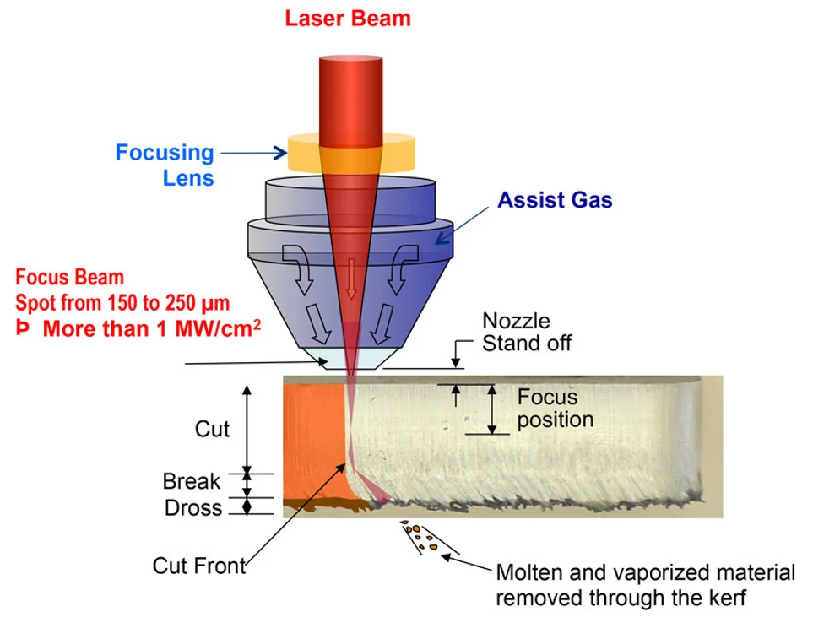
Laser Beam
Laser cutting is mainly a thermal process in which a focused laser beam is used to melt material in a localized area.
A device that emits light by exciting photons through electrical current flowing through a substrate with excitable electrons

Slide 5
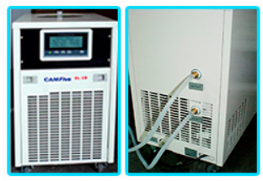
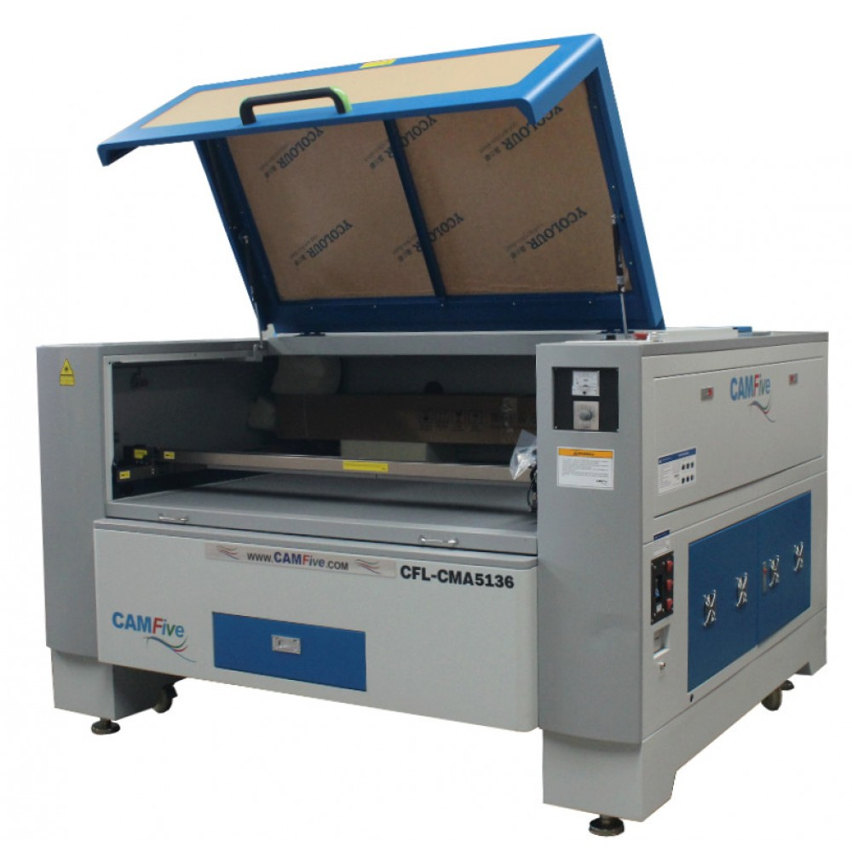
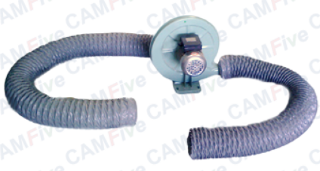
L3Harris Student Design Center
CAMFive CFL-CMA1200
Water Chiller Unit
Fume Extraction System

Slide 6
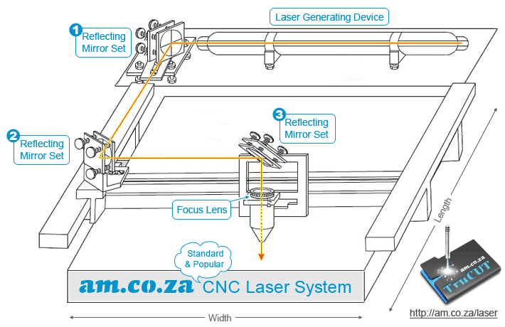
System of Mirrors
A high-energy beam emitted from one end of the laser tube passes through a system of prisms and hits the mirror of the laser head, which deflects it down.

Slide 7
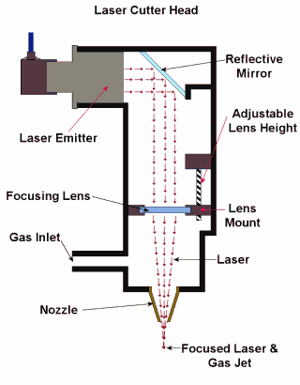
Laser Cutter
System of Mirrors
A special focusing lens “collects” the beam in a narrow beam (about a fraction of a millimeter) directly on the surface of the work piece.

Slide 8
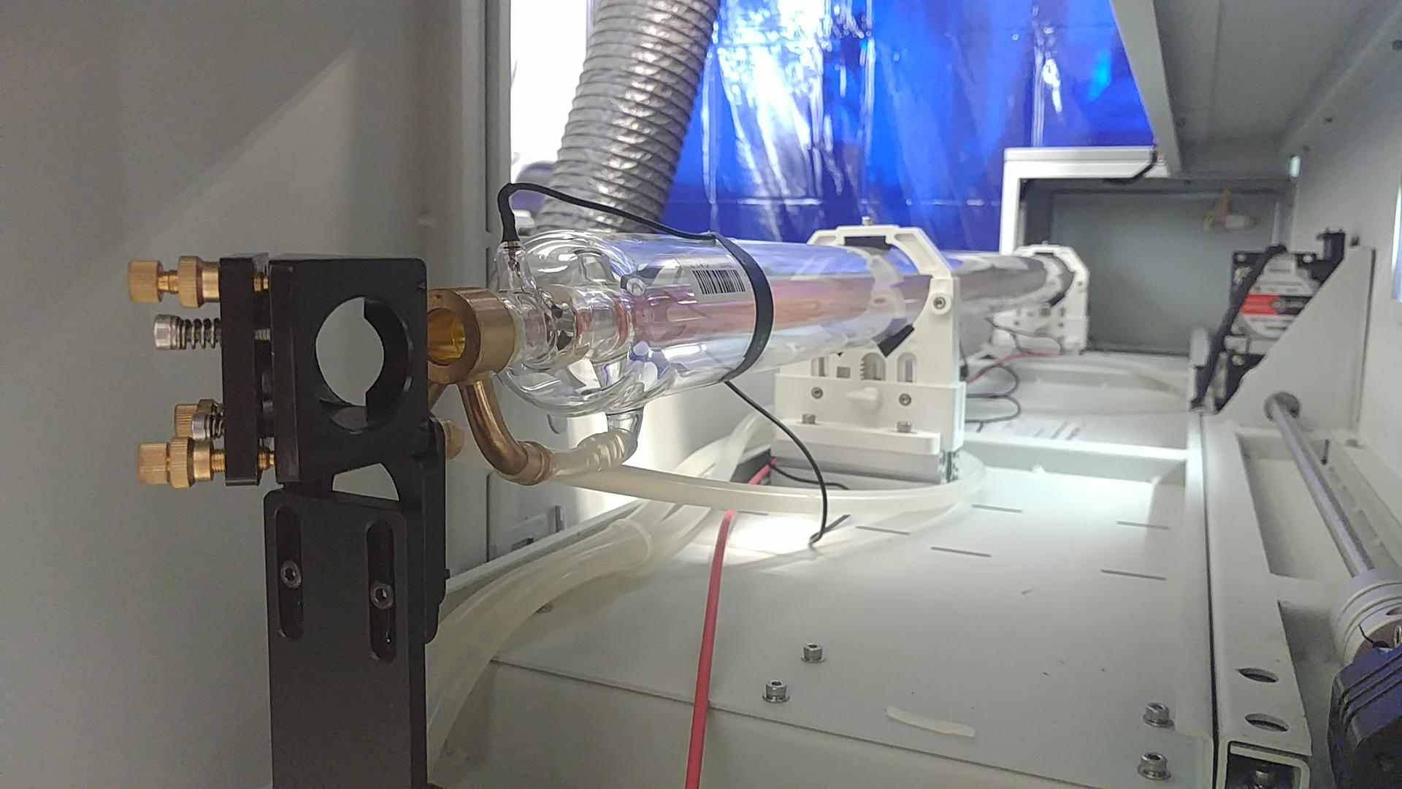
Laser Tube
How does a CO₂ laser tube work?
In short, a photonic laser beam is generated when CO₂ gases inside a sealed tube are excited by electrical energy.
The laser emits this electrical energy in the form of an invisible, infrared, laser, light beam that is powerful and focused and can be used for material cutting, engraving, and marking.

Slide 9
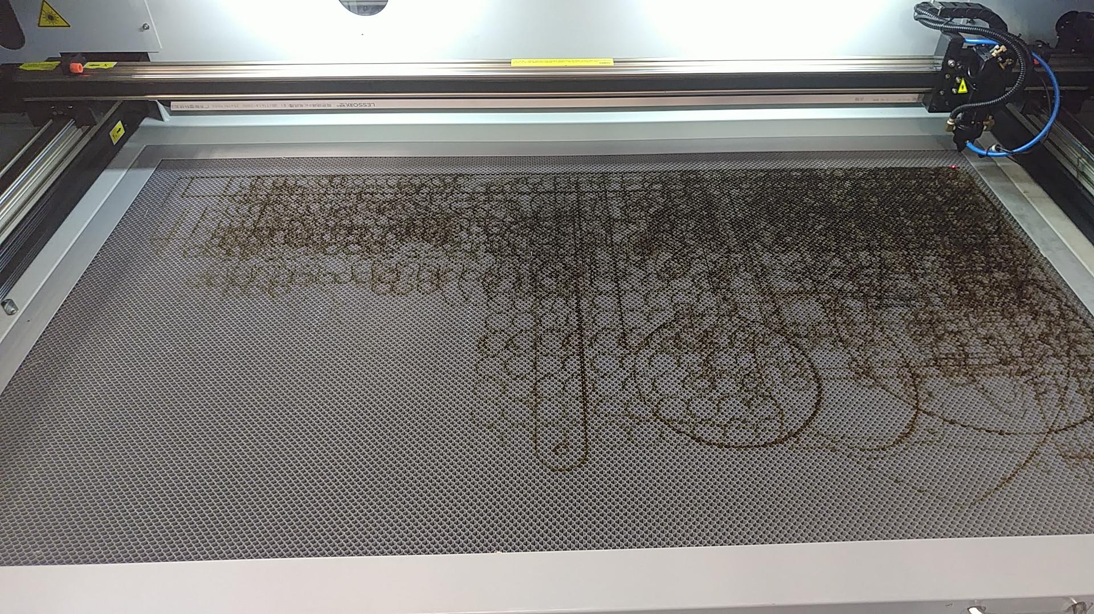
Laser Bed
L3HSDC has two laser cutters with 2' x 4' cutting bed area
Make sure NOT to engrave the bed by knowing where your origin is defined!
Must be present to cut because of possible fire

Slide 10
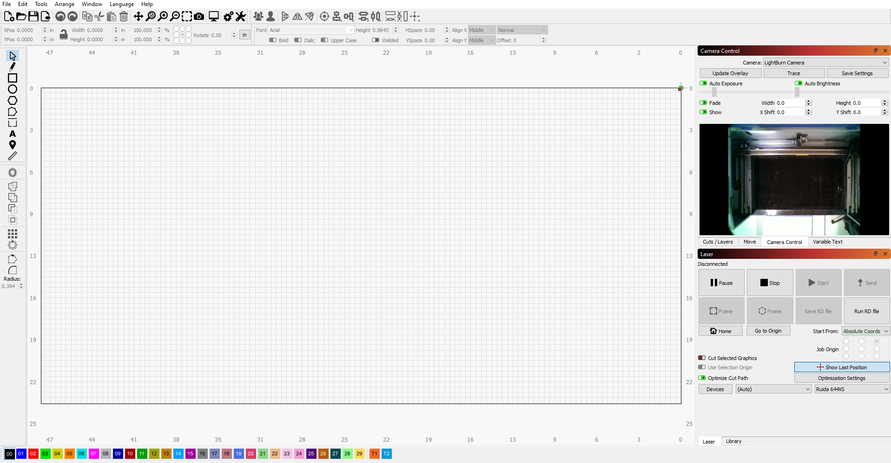
LightBurn Laser Cutter Software
Directly interfaces with the laser
Cutting bed analysis via camera
Intuitive User Interface
When I'm done, go to
https://fit.instructure.com/courses/574154
scroll down to LightBurn, and try to view and do
the first one or two tutorials

Slide 11
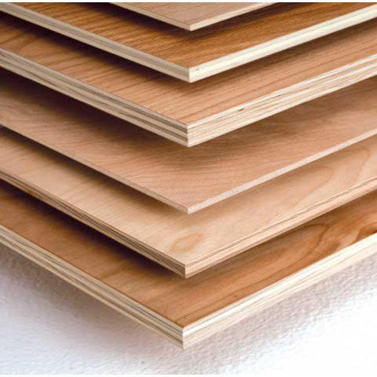
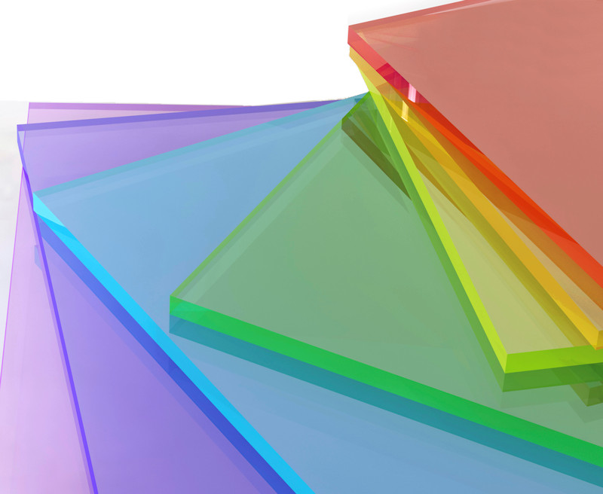
Laser Cutter Material
Materials that can be used at the L3HSDC
Plywood
Acrylic
Cardboard
Max Power: 85
Min Power: 80
Speed: 27 mm/s
Max Power: 85
Min Power: 80
Speed: 15 mm/s
Max Power: 35
Min Power: 30
Speed: 90 mm/s
All the material above can be cut and etched

Slide 12
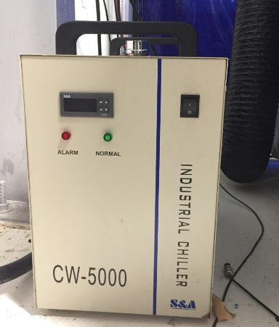
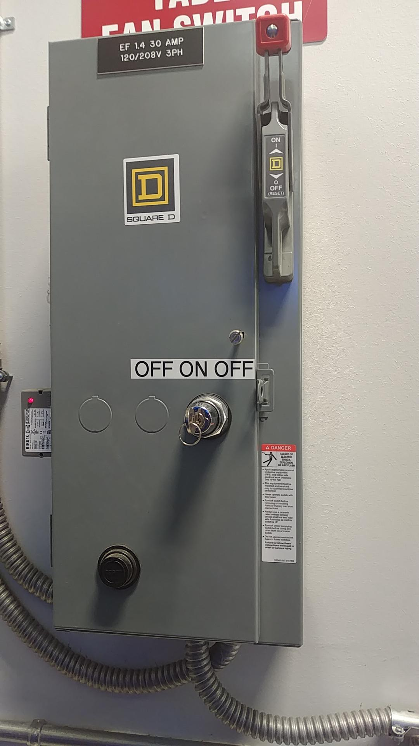
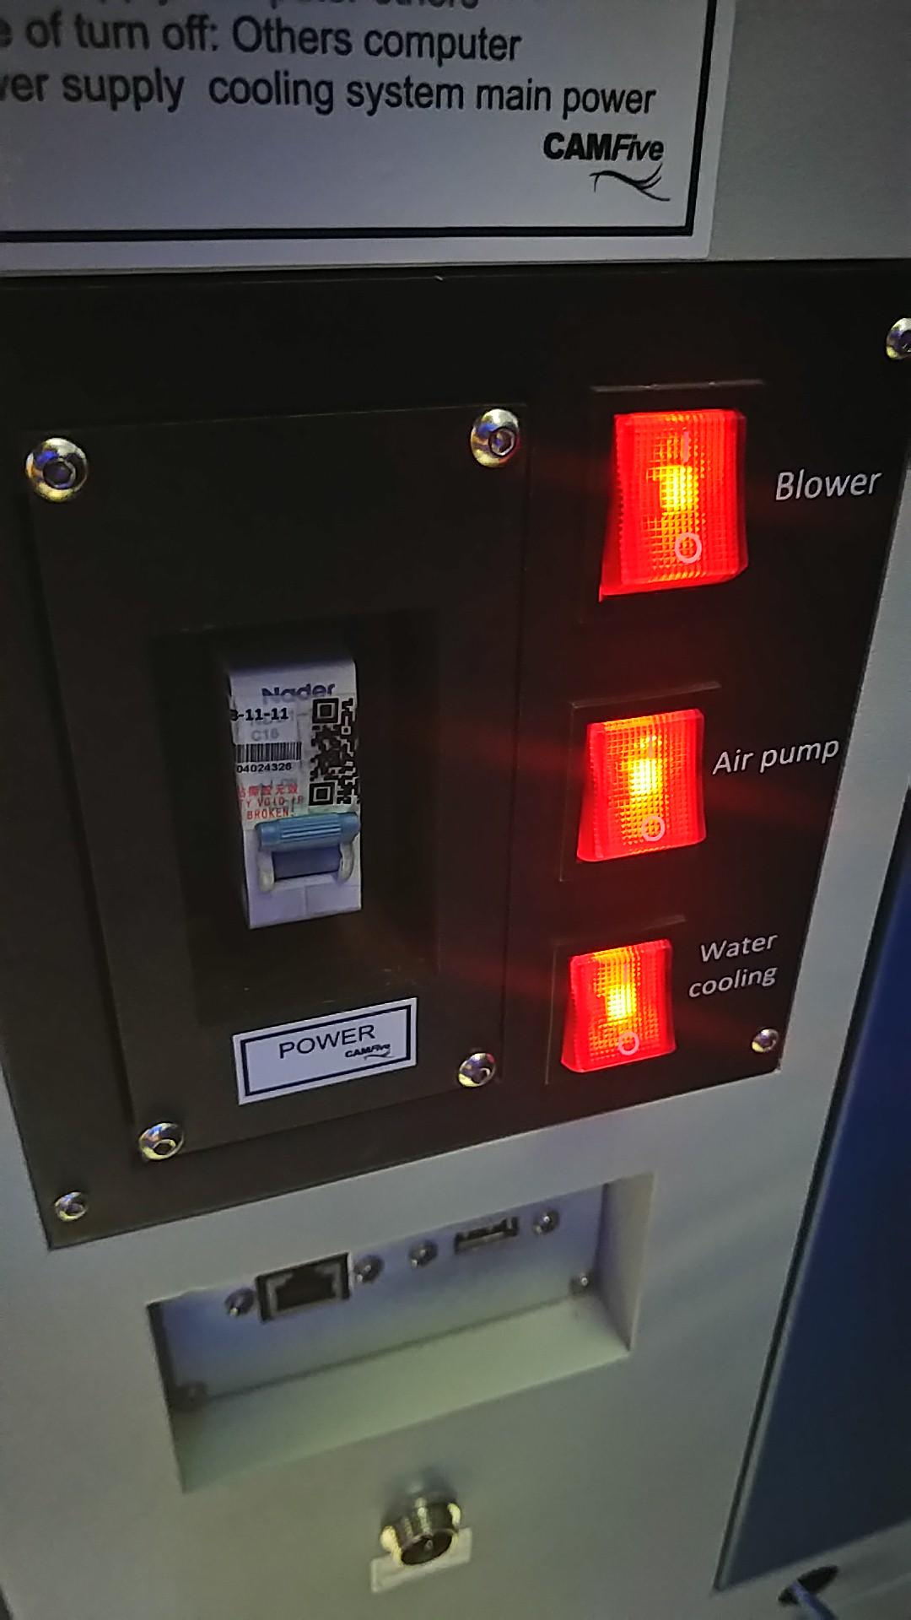
Laser Cutter Usage
2.
Steps to use the Laser
Turn on ventilation for the fume extractor in the laser cutter
Turn on the chiller to allow the laser to be water cooled
Plug in your USB
Turn on the master power switch
Make sure the switches for laser cutter blower, air pump, and water cooling are in the on position
1.
3.

Slide 13
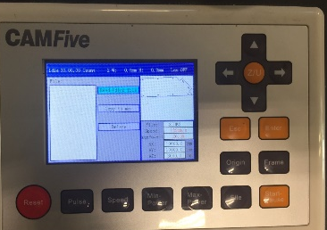
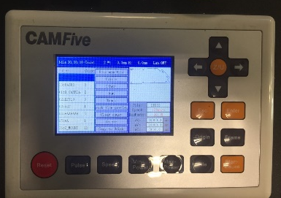
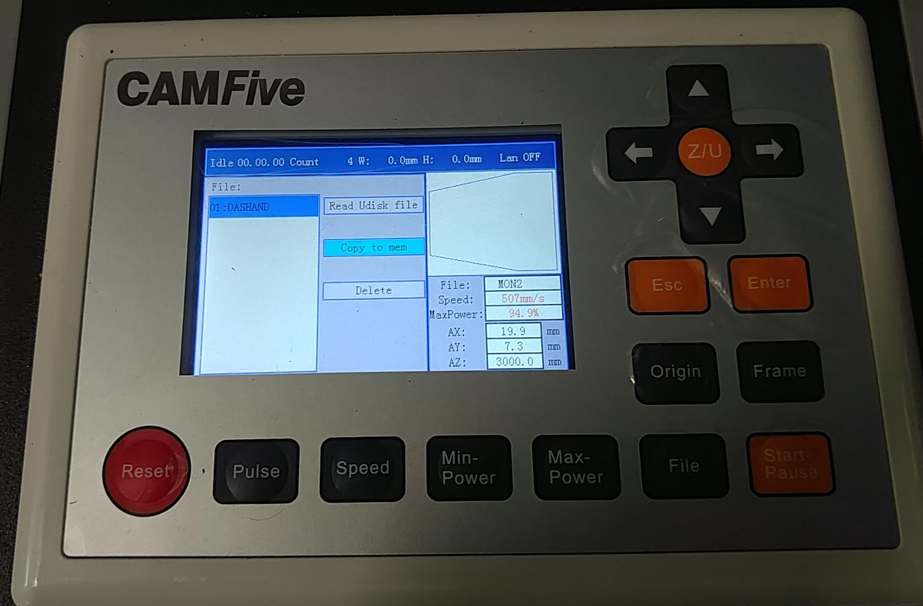
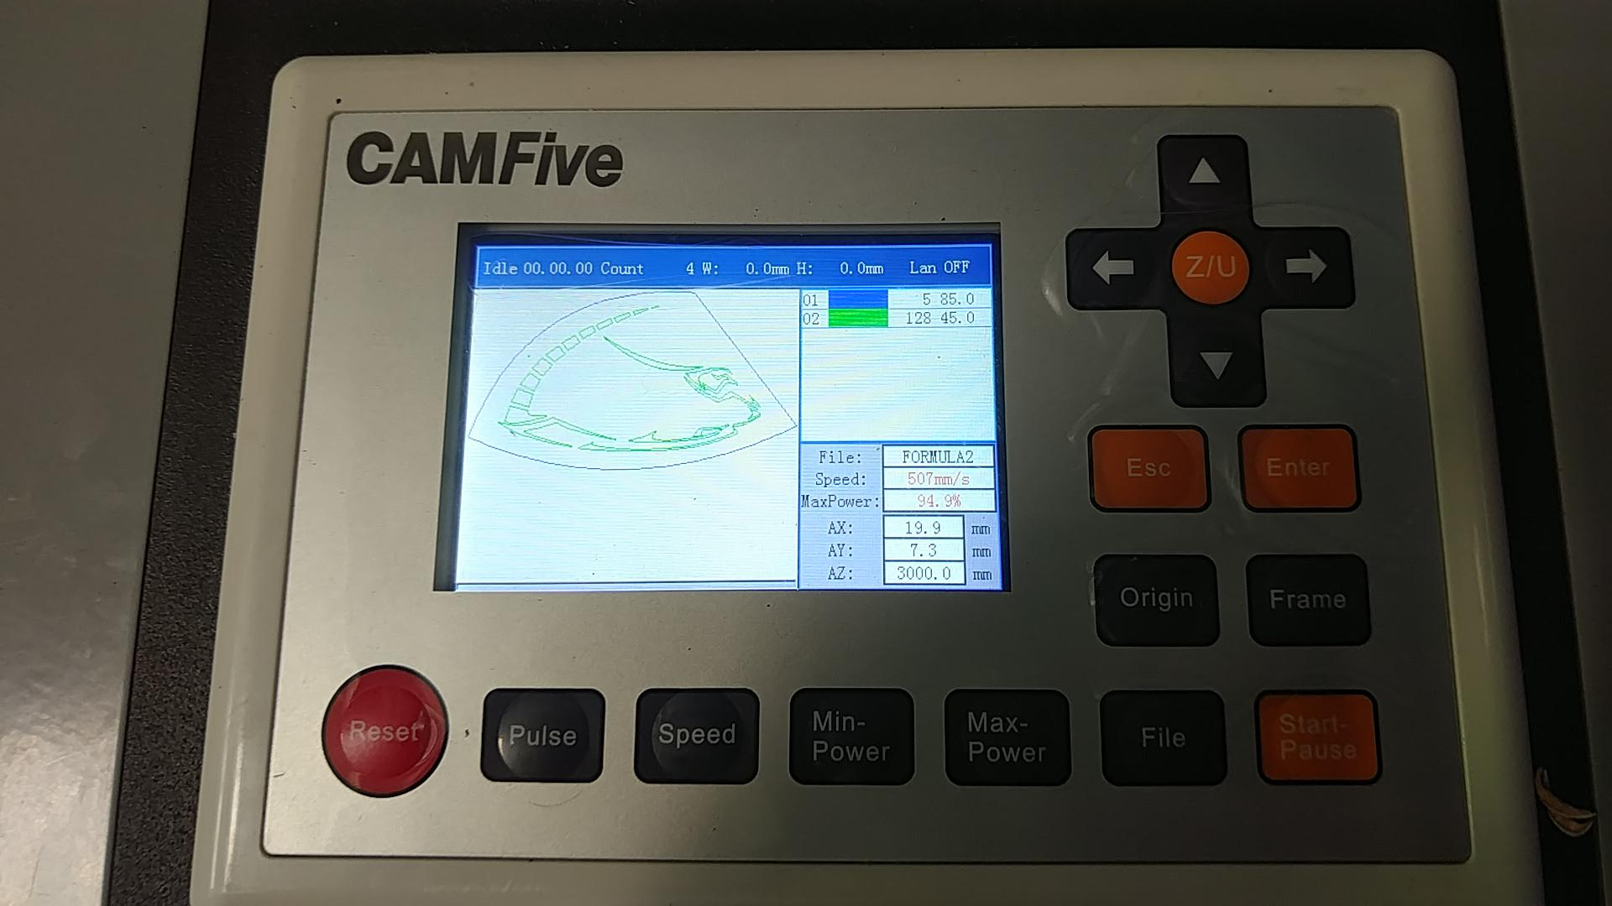
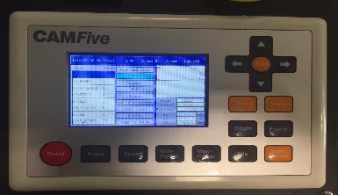
Laser Cutter Usage
Steps to use the Laser Controller
Use the Laser Cutter Key to turn on the controller on
Press File to see all of the files on the laser and bring up the main menu
Use the arrow keys to go to UDISK, press Enter
Highlight Read UDISK File, press Enter and look for your file
Highlight your file, press enter ->Copy to Memory
The laser should tell you the file is saved on the laser's internal memory
Press File and use the arrow keys to find your file and press enter to bring up your design
1.
4.
2.
5.
3.
6.

Slide 14
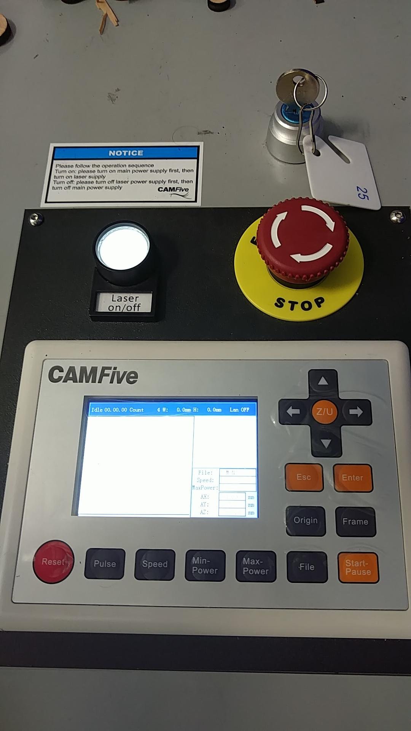
Laser Cutter Usage
Using the Laser
Once your design is uploaded and displayed on the laser cutter you should:
Select an origin point
Frame your design in the cutting bed
Turn the laser on using the Laser on/off button
Press the Start-Pause button to cut

Slide 15
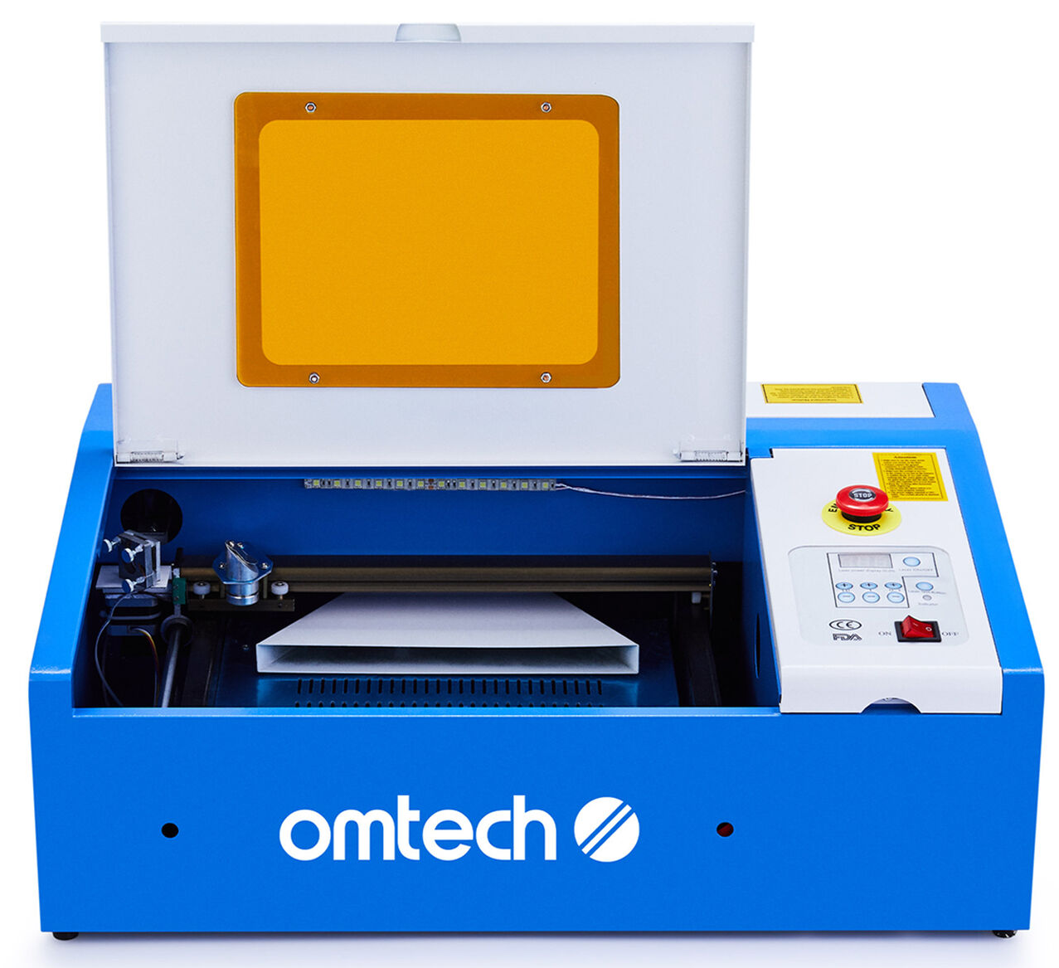
CAMID K40 Laser Engravers
K40 Laser Engraver - https://www.ebay.com/itm/253313831369 for $340 (normally $420)
K40 Whisperer Manual - https://www.scorchworks.com/K40whisperer/k40w_manual.html

Slide 16
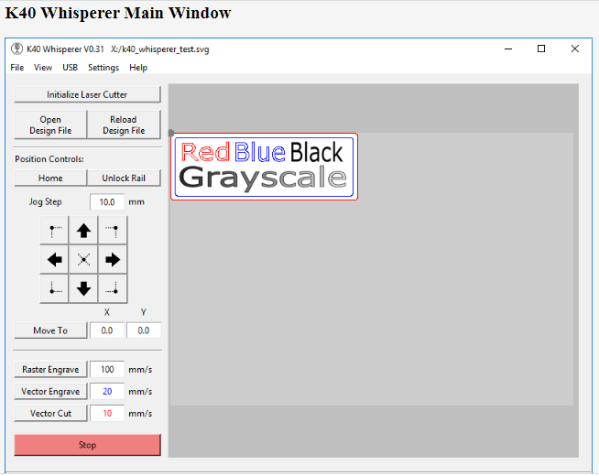
K40 Whisperer Software for CAMID K40 Laser Engravers
K40 Laser Engraver - https://www.scorchworks.com/K40whisperer/k40w_manual.html
K40 Whisperer Web Site - https://www.scorchworks.com/K40whisperer/k40w_manual.html
K40 Whisperer Manual - https://www.scorchworks.com/K40whisperer/k40w_manual.html

Slide 17
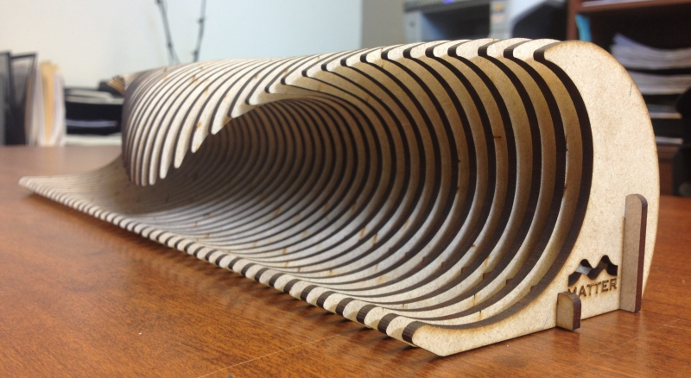
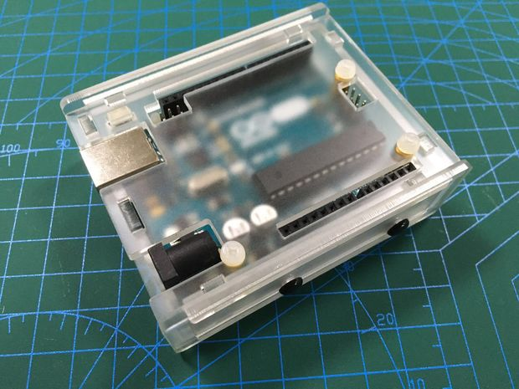
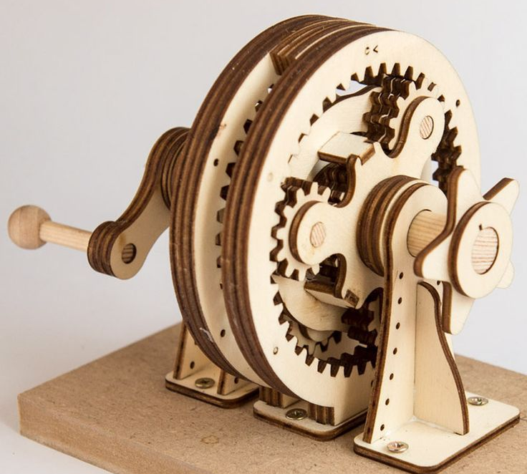
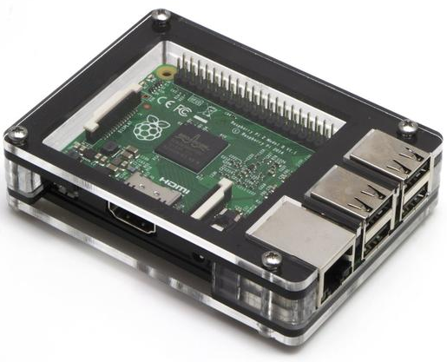
Laser Cutter Usage
Applications

Slide 18
Questions

